Slide 1

Data Analyst Internship – Capstone Project
Prepared by: Srikanth
Customer Purchase Behavior Analysis
A deep dive into sales data to uncover valuable business insights and drive strategic recommendations.

Slide 2

Project Objective: Unlocking Customer Value
This capstone project aimed to meticulously analyze customer purchase behavior. Our goal was to:
Identify significant purchasing trends.
Define and track key performance indicators (KPIs).
Derive actionable business insights to inform strategic decisions.
All findings were visualized and presented using the robust capabilities of Power BI.

Slide 3




Tools & Technologies: Our Analytical Arsenal
Power BI Desktop
DAX (Data Analysis Expressions)
CSV Dataset
GitHub
For interactive dashboards and compelling data visualization.
The primary data source containing comprehensive customer purchase records.
For version control and collaborative project management.
For creating complex calculations and custom measures within Power BI.

Slide 4
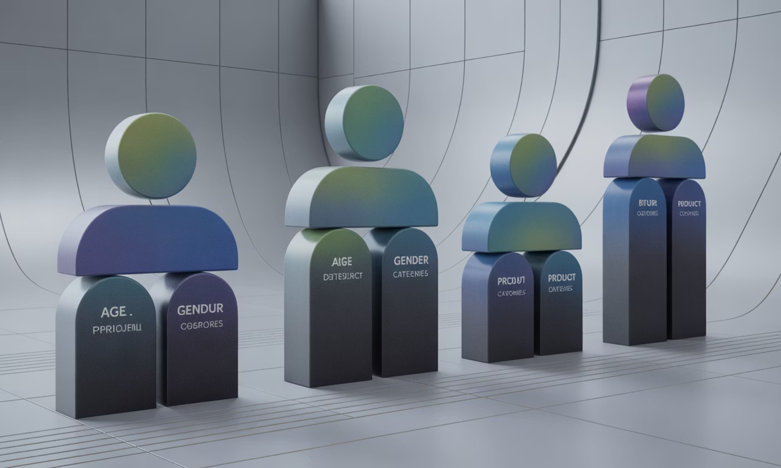
Dataset Overview: A Glimpse into Customer Data
Our analysis was built upon a rich customer-level purchase dataset, encompassing crucial demographic and transactional information:
Age & Gender: Understanding demographic segmentation.
City: Identifying geographical purchase patterns.
Product Category: Pinpointing popular product segments.
Purchase Amount: Analyzing spending habits.
Payment Method: Revealing preferred transaction types.

Slide 5




Exploratory Data Analysis: Initial Discoveries
Our initial exploration of the dataset revealed several significant patterns:
Top Cities & Categories
Payment Method Preferences
Age-Based Spending
Identified leading cities and product categories by sales volume.
Uncovered distinct spending patterns across different age demographics.
Analyzed the most frequently used payment methods among customers.

Slide 6
Key Performance Indicators (KPIs): Measuring Success
To quantify performance and track progress, we established several vital KPIs:
1
2
3
4
Total Sales
Avg. Purchase Value
Top Product Category
Top Performing City
Overall revenue generated from purchases.
The mean value of each customer transaction.
The highest-grossing product group.
The geographical region with the highest sales.

Slide 7
Dashboard Features: Interactive Insights in Power BI
Enhanced User Experience
Interactive Slicers: Allowing users to filter data by various dimensions.
KPI Cards: Providing at-a-glance summaries of key metrics.
Dynamic Filtering (DAX): Enabling advanced, customized data views.
Clean Visual Layout: Ensuring readability and aesthetic appeal.
Our Power BI dashboard was designed for intuitive interaction and clear data presentation.
Interactive data exploration.
Real-time insights for decision-makers.

Slide 8

Key Business Insights: Data-Driven Discoveries
Age 36-45: Highest Spend
Electronics: Top Revenue
Delhi & Bangalore Lead
Our analysis yielded critical insights that can directly influence business strategy and marketing efforts.

Slide 9



Actionable Recommendations: Strategic Growth
Target High-Spending Demographics
Promote Electronics Category
Expand in Top-Performing Cities
Focus marketing campaigns on the 36-45 age group, leveraging their higher spending propensity.
Invest further in marketing and inventory for electronics, given its substantial revenue contribution.
Allocate more resources and efforts to Delhi and Bangalore, which are proven sales leaders.

Slide 10

Conclusion: Demonstrating Analytical Prowess
This project successfully demonstrates an end-to-end data analytics workflow, from raw data to actionable business recommendations.
It showcases my proficiency in Power BI, DAX, and a comprehensive understanding of business analytics principles.

